Slide 1

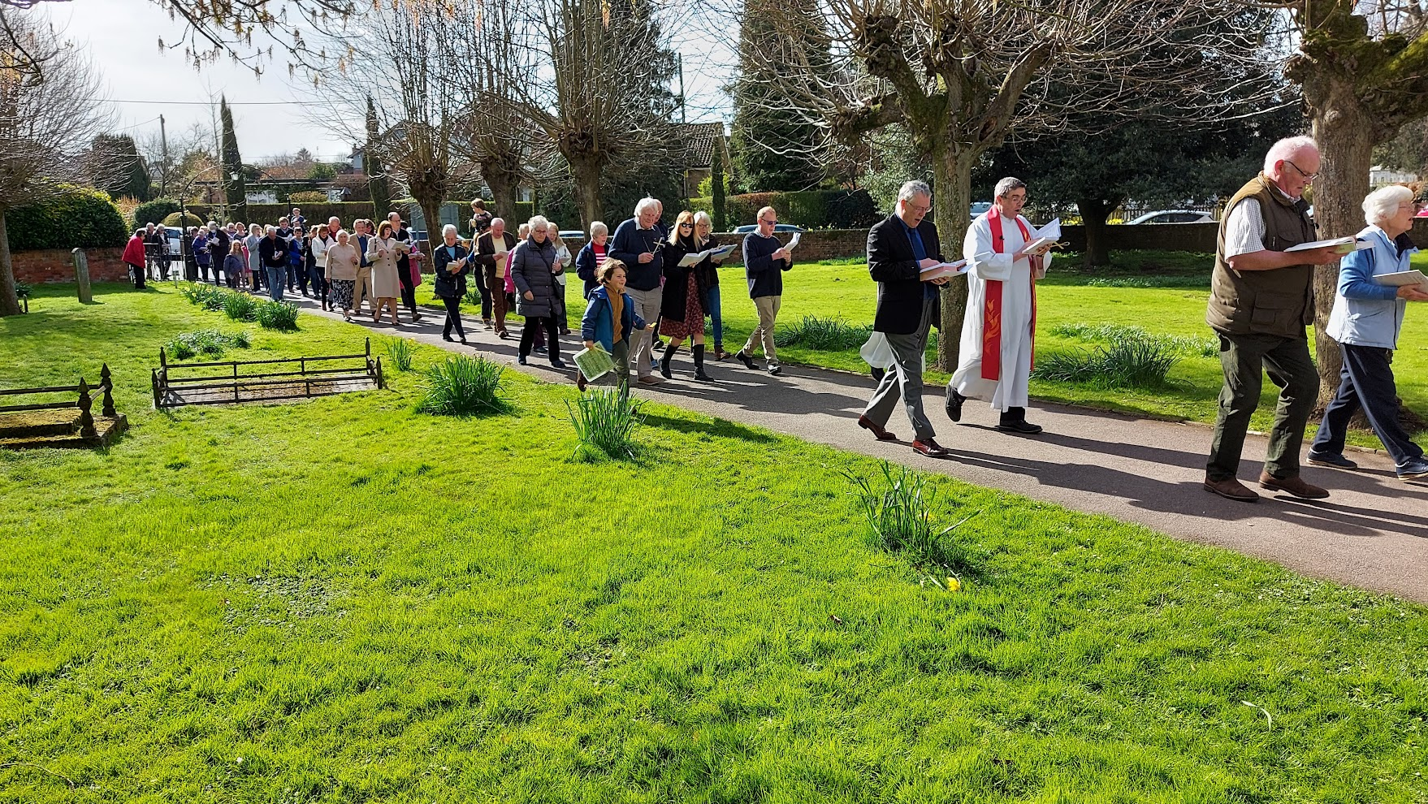
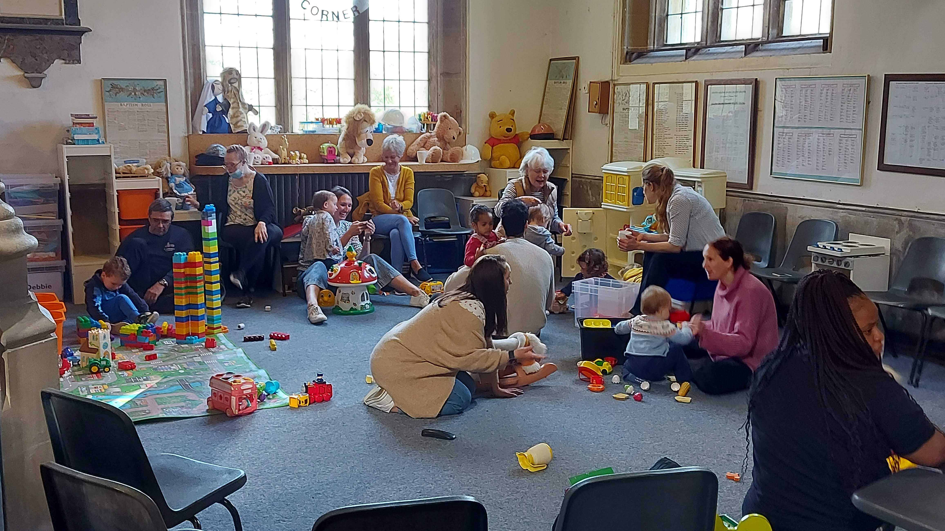
BUILDING PROJECT

Slide 2
OUR VISION
Our vision is to be a growing church at the heart of Hungerford. To show Jesus's love in our community in word and deed, and
to tell the stories of Jesus in our worship and mission
This building project will enable us to significantly expand our ministry, we seek to serve both one another and the town better

Slide 3
CURRENT ISSUES
The church feels unwelcoming with solid inner doors which people cannot see through
The boiler is at end of life, the heating system lacks zones and the church is cold preventing some events being run in the winter
21% of the town’s population is under 19, yet we have limited provision for children under 5 during Sunday services and primary age children must meet offsite during services
There is only one WC, with no disabled access or facilities for baby changing
The servery is not suitable with for example no oven, hob or fridge
Substantial space within the church is underused or not used – especially on the balcony

Slide 4
WHAT IS PLANNED
Glass doors to front of church
A new boiler, better insulation and improved heating system with separate zones
3 meeting spaces, one of which to have audio/video feed from main auditorium
Installation of 2 WCs, including one with disabled access and baby changing
A new, fully-equipped, kitchen
Improved direct access to first floor
Better storage
Other minor re-arrangements to make the church more functional

Slide 5
EXISTING GROUND FLOOR PLAN

Slide 6
PROPOSED GROUND FLOOR PLAN

Slide 7
EXISTING FIRST FLOOR PLAN

Slide 8
PROPOSED FIRST FLOOR PLAN

Slide 9
PROJECT COSTS
£ 63,000 for professional fees and planning application.
£ 20,000 for the new glass doors
£615,000 for the remainder of the project
£ 75,000 for contingency and tender price inflation
£773,000 TOTAL
All costs are net of VAT except where this is not recoverable

Slide 10
FUNDING AND TIMING
£350,000 from historic reserves and bequests
£100,000 we hope will come from Greenham Common Trust
£100,000 we hope will come from other grant giving bodies
£223,000 we hope will come from congregation and the Hungerford community
£773,000 TOTAL
Fundraising period
November 2022—November 2023
Main Building period
11 April 2023—10 November 2023

Slide 11
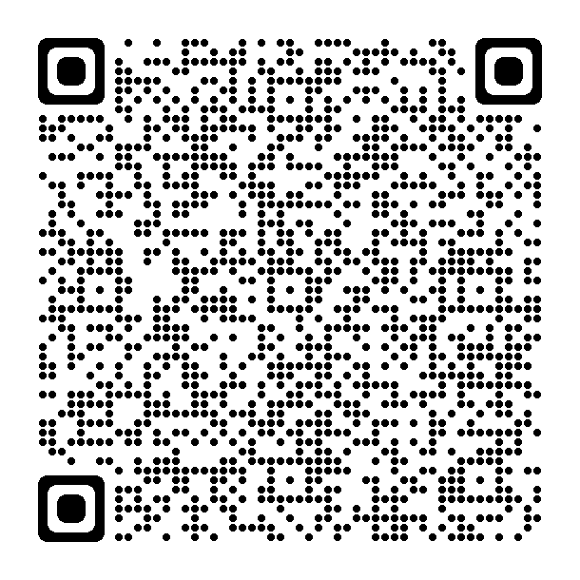
HOW TO GIVE?
The church has an initial £50,000 matched funding facility with the Greenham Trust via the good exchange, with the possibility of another £50,000. You can give to it by:-
Following the links from the church website StLawrencesHungerford.org.uk. This will be doubled by Greenham Trust and the tax reclaimed.
2. Scanning the QR Code. This will be doubled by Greenham Trust and the tax reclaimed.
3. A cheque payable to “Greenham Trust Ltd” in an envelope marked “Building for the Future” delivered to the vicarage or one of the staff. This will be doubled by Greenham Trust

